Slide 1
Simple Network Operations
Chapter 8

Slide 2
Learning Objectives
Explain operation fundamentals of network operating systems
Understand various networking software components
Describe basic steps required for network operating system installation
Define network services
Understand network application installation and configuration concepts

Slide 3
Network Operating Systems
Network Operating Systems Overview
Initially, merely communications software packages or additions to standalone operating systems
Example: Microsoft LAN Manager
Later, true network operating systems handled network communications and operations of standalone computer
Examples: Novell NetWare, Windows NT Server, Windows 2000 Server, Windows .NET Server, UNIX, and Linux

Slide 4
NOS Demands
Multitasking – able to support numerous processes simultaneously
True multitasking requires as many CPUs as simultaneous processes
Time slicing simulates multitasking
Two types of multitasking
Preemptive multitasking – OS controls what process gets access to CPU and for how long
Cooperative multitasking – relies on process itself to relinquish control of CPU

Slide 5
Software Components of Networking
True NOS Manages activities of local computer and enables communication over network media
Connects all machines and peripherals; coordinates and controls functions of machines and peripherals
Supports security and privacy; controls access to resources on a user authentication basis
Advertises and manages resources from centralized directory; gives ability to share resources such as printers
Includes client and server network software

Slide 6
General NOS Components
NOS includes many software components and services
Naming Services
Directory Services
Client Network Software
Server Network Software

Slide 7
Naming Services
Most networks require name to identify and access resources on network
Naming services translate symbolic names into corresponding network addresses

Slide 8
More About NetBIOS Names
Prior to Windows 2000, Microsoft networking used NetBIOS names
Rules of NetBIOS naming
No longer than 15 characters
Table 8-1 shows characters not allowed in names
End name with dollar sign to hide it

Slide 9
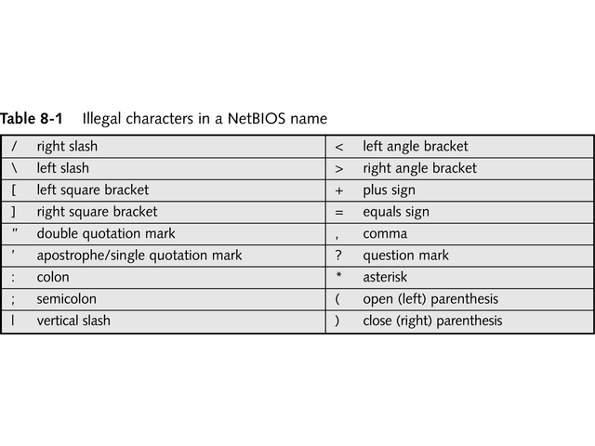
Illegal Characters in NetBIOS Name

Slide 10
Microsoft’s Universal Naming Convention
Drive mapping associates network drive resource with local drive letter
Another standard method uses Universal Naming Convention (UNC) name
Form is \\servername\sharename
UNC-aware applications may use UNC name rather than drive letter

Slide 11
Domain Names and DNS
Domain Name System (DNS) translates domain names into numeric IP addresses
Allows users to access resources by using text-based domain name
Windows 2000 Server introduced Dynamic DNS (DDNS)
Will replace NetBIOS naming service in Microsoft networks

Slide 12
Directory Services
Allow users to look up things by name or by type of service or resource (such as printers)
Two complete directory services that use “tree and forest” metaphor to organize directory content are:
Active Directory, introduced with Windows 2000
Novell Directory Services (NDS), introduced with Novell NetWare version 4
May use add-on directory services for Linux

Slide 13
Directory Services
Directory servers also store access control
Both Active Directory and NDS are built on X.500
Lightweight Directory Access Protocol (LDAP) has less overhead than X.500
Easier to implement
Supports remote devices

Slide 14
Client Network Software
Installed on user’s computer; requests resources from server
Redirector is most important software component
Operates on both client and server at Presentation level
Intercepts user’s request, examines it, and determines if request can be filled by local CPU
If not, redirector routes requests over network to server or host of resource

Slide 15
Client Network Software
Designator is another NOS software component
Aids in interaction with network resource
Keeps track of drive letters assigned locally to remote or shared drives
Substitutes real network address for mapped drive letter
Both redirector and designator are important for file and print sharing

Slide 16
Server Network Software
Hands out resources and services to clients
Server components are more complex than client components
Allows sharing of resources, as seen in Figure 8-1
Restricts access to resources
Called access controls
Provide data privacy and protection

Slide 17
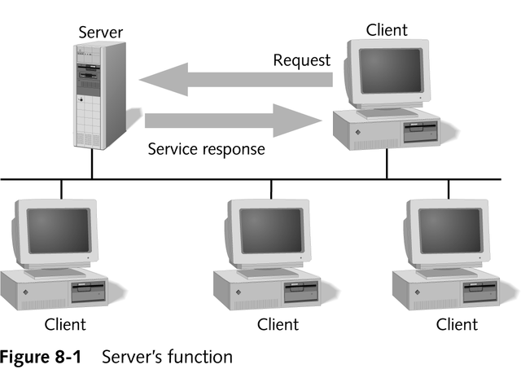
Server’s Functions

Slide 18
Server Network Software
Other responsibilities of server NOS include:
Management of users and groups
Resource advertisement, name services, and directory services
Logon authentication of users
Management, control, and auditing tools to administer network
Fault-tolerance to protect integrity of network and its data

Slide 19
Client and Server
Many NOSs include client and server capabilities in Server and Professional versions
Examples: Windows 2000 and Windows XP
Linux uses same version to run workstations and servers

Slide 20
Installing a Network Operating System
Much like installing standalone operating system
Few extra steps for configuration of network and server services
Important to complete preparatory steps before installing NOS

Slide 21
Installation Preparation
Understand many aspects of network before installing NOS, including:
Type of network (topology)
Size of network
Job requirements of server
File system to be used
Identification or naming convention
Types of OSs on servers and clients
Organization of storage devices

Slide 22
Job Requirements
Evaluate services that machine will do, including:
DNS
DHCP
Web services
Remote access
In Windows networking, server may be:
Domain controller – maintains directory and security database
Member server – hosts services and resources

Slide 23
Job Requirements
Some servers support fault tolerant features
Disk mirroring
Disk duplexing
Redundant Array of Inexpensive Disks (RAID)

Slide 24
Naming Conventions
Good naming convention includes user accounts, computers, directories, network shares, printers, and servers
Names should be descriptive
Conventions should be:
Consistent across all objects
Easy to use and understand
Simple to construct new names
Clearly identify object types

Slide 25
Storage Device Organization
Most important decision involves drive partitioning
Partition is logical organization of disk space
Different schools of thought about organizing NOS host drive:
Multiple-boot
Single-partition, single-NOS
Multiple-partition, single-NOS
Fault-Tolerant Storage

Slide 26
Storage Device Organization
File system is second important issue:
Some high-performance file systems, such as NTFS, provide object-level security
Others, such as FAT, are less secure, but offer compatibility with other OSs

Slide 27
Network Adapter Configuration
Configure NIC before installing NOS
Use manufacturer-supplied BIOS configuration utility
Define and test all possible NIC settings
Set cable type and bus slot number

Slide 28
Protocol Selection
Determine what protocol you will use before installing NOS
TCP/IP, world’s most common protocol, requires this information before NOS installation begins:
IP address
Subnet mask
Default gateway
DNS
WINS
DHCP

Slide 29
Hardware Compatibility
Hardware must be compatible with NOS
Most vendors publish compatibility lists
Microsoft term is Hardware Compatibility List (HCL)
If using incompatible hardware, vendor may not provide technical support

Slide 30
Installing Microsoft Windows Servers
Setup Wizard makes installation easy
Three parts of Windows 2000 or Windows NT 4.0 installation:
Text-based portion – configures hard drives and file system, confirms license, and defines name of system directory, as seen in Figure 8-2
Graphical user interface portion – defines computer and domain name, enters identification key, selects server type, and assigns Administrator password
Network portion – installs NIC drivers, selects protocols, and reviews bindery

Slide 31
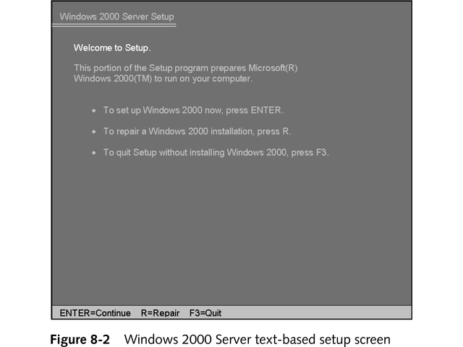
Windows 2000 Server Text-Based Setup Screen

Slide 32
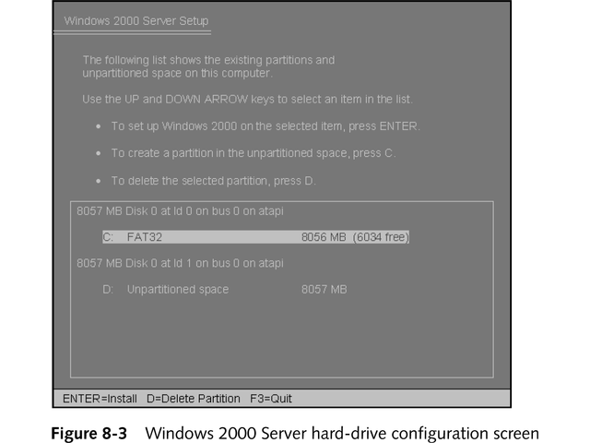
Windows 2000 Server Hard Drive Configuration

Slide 33
Installing Novell NetWare 6.0
Two installation methods:
Over the network
From a CD-ROM
INSTALL.NLM is primary install utility
Installs in two phases:
Character mode
GUI mode

Slide 34
Installing Red Hat Linux 7.3
Before installing Linux, defragment hard drive and use CHKDSK to verify clusters
Red Hat Linux comes on three CD-ROM disks
Two possible installation modes:
Text – type “text” at boot prompt
Graphical – default mode; press Enter key
Choose kind of installation, as shown in Figure 8-4

Slide 35
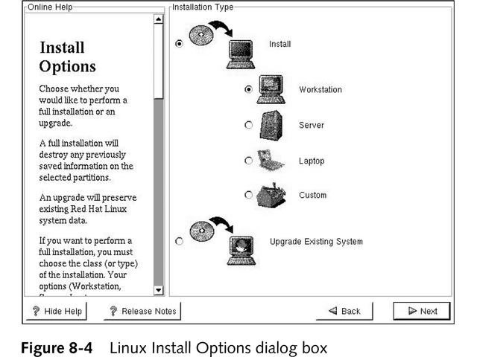
Linux Install Options

Slide 36
Installing Red Hat Linux 7.3
Choose boot loader
Program that lets user choose which operating system to load
See Figure 8-5
Select level of security
Customize built-in firewall
See Figure 8-6

Slide 37
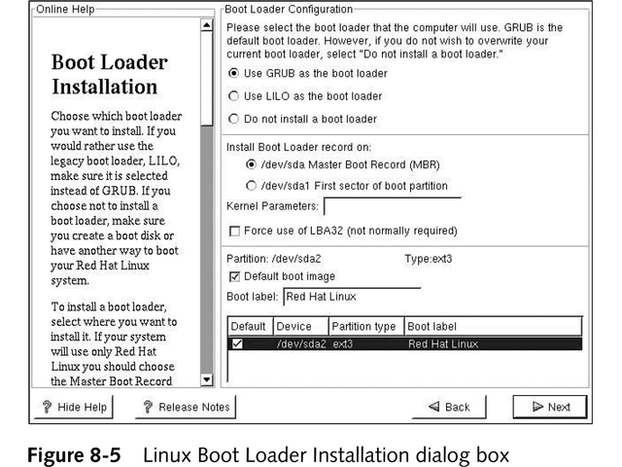
Linux Boot Loader Installation

Slide 38
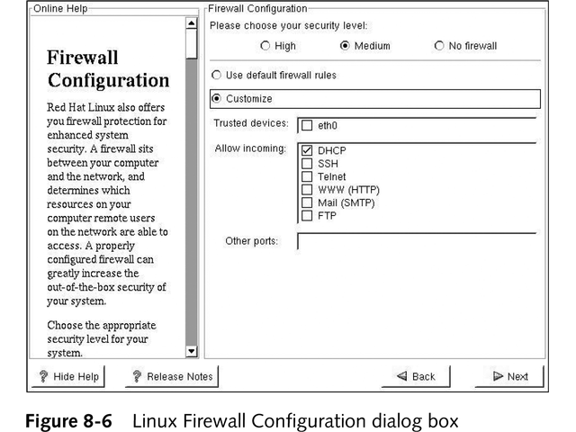
Linux Firewall Configuration

Slide 39
Network Services
Wide range of possible network services
Two primary services are printers and directory shares
Others services include:
Groupware applications
Mail packages
Shared whiteboard applications
Web servers

Slide 40
Installing, Removing, and Configuring Network Services
Driver or network itself provides network service
Most NOSs have administrative tool for installing and removing network services
Figure 8-1 shows Windows Components Wizard
Control network services in two ways:
Through global services administrative tool
Through console plug-in related to specific service
Add new tools under the Microsoft Management Console (MMC)

Slide 41
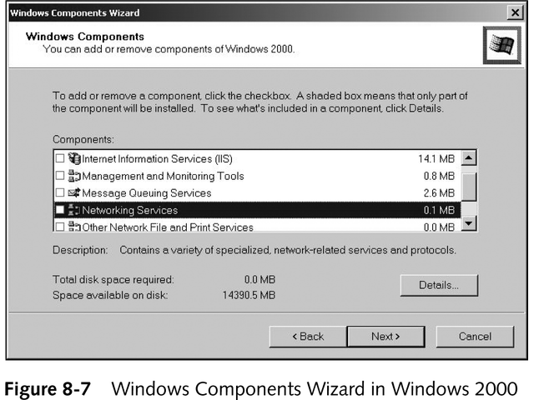
Windows Components Wizard in Windows 2000

Slide 42
Network Bindings
Process of linking network components from various levels of network architecture to ensure communication between them
Associates upper-layer services and protocols to lower-layer network adapter drivers
Bind most frequently used protocol, service, or adapter first to speed network connections

Slide 43
Network Printing
Redirector intercepts printer requests and forwards them to print servers or network-connected printers
Network printing involves installing printer
Some clients require local printer drivers
Others access printer drivers from print server
New local printer points to print share, as shown in Figure 8-8

Slide 44
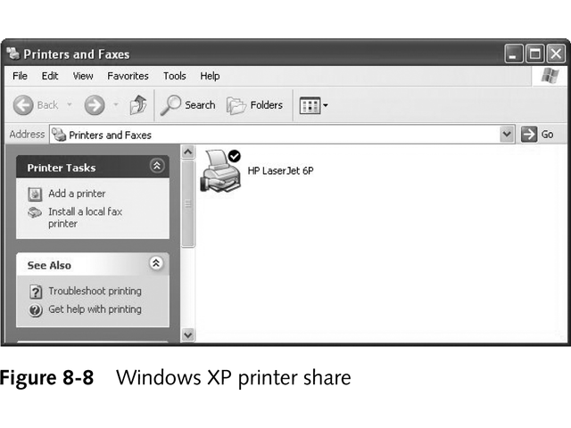
Windows XP Printer Share

Slide 45
Printer Management
Manage printers from local direct access or through network printer share;
Windows 2000 lets you manage printers through Web browser
Printer management includes:
Granting and restricting user access to printers
Monitoring print queue
Limiting access by time frame, department, or priority
Updating local and remote printer drivers
Maintaining printers; managing printers remotely

Slide 46
Sharing Fax Modems
Feature not usually default component in NOS
Use third-party add-on product
Once drivers are installed, manage and administer fax shares like printer shares

Slide 47
Network Directory Shares
Let clients access and interact with storage devices on network
“Offering hand” in Figure 8-9 indicates shared folder
Three ways to access shared directory:
Map unused local drive letter to directory share
Use UNC name to reference directory share
Selecting directory share from list of available shares
Manage directory share by granting or restricting user access levels

Slide 48
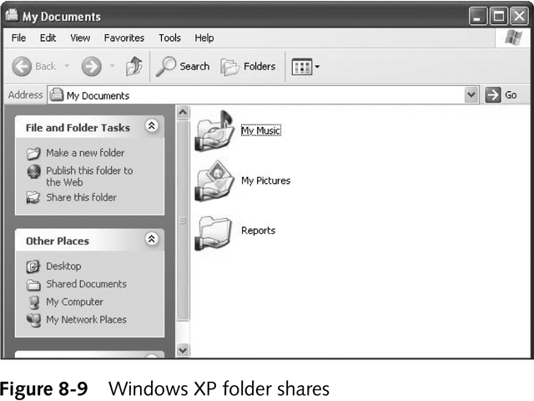
Windows XP Folder Shares

Slide 49
Network Applications
Designed for multiple simultaneous users on numerous computers on network
Three essential types of network application tools:
E-mail or messaging
Scheduling or calendaring
Groupware
Easier to administer
Poor network performance or limited bandwidth degrades application performance

Slide 50
Network Applications
If network is down, application is unusable
Three types of architecture for network applications:
Centralized – applications operate only on server
File-system sharing – application on client, but share database or storage directory
True client/server – some resides on server and some on client; group activities processed on server

Slide 51
E-Mail or Messaging
Distributes messages across network or Internet
Internet mail standards include SMTP, POP3, and/or IMAP
Includes many sophisticated abilities, such as attaching files, filtering, using distribution lists, and address book

Slide 52
E-Mail or Messaging
Numerous e-mail protocols, including:
X.400 – hardware- and software-independent message-handling protocol
Internet Message Access Protocol (IMAP) – includes advanced message controls and fault tolerance
Message Handling System (MHS) – Novell standard similar to X.400

Slide 53
E-Mail or Messaging
Numerous e-mail protocols, including:
Post Office Protocol, version 3 (POP3) – used by e-mail clients to download incoming messages
Simple Mail Transfer Protocol (SMTP) – current standard for Internet e-mail
X.500 – similar to X.400, but offers improved directory services

Slide 54
Scheduling or Calendaring
Provides easy coordination of meetings and appointments
Most offer private and public calendars, appointment books, task lists, and contact address books
May offer reminders of special events
Often integrated into e-mail programs
May print daily, weekly, monthly, and yearly schedules

Slide 55
Groupware
Lets multiple users interact simultaneously with single file, document, or project
Most popular multiuser multimedia authoring tools include Lotus Notes, Novell’s GroupWise, and DEC’s TeamLinks
Able to synchronize users and coordinate distributed data and activities

Slide 56
Chapter Summary
Network operating system (NOS) is software that controls operations of computer, including local hardware activity as well as communication over network media
Most NOS are multitasking systems because they support both local and remote activities
NOS enables sharing resources, managing peripherals, maintaining security, supporting privacy, and controlling user access

Slide 57
Chapter Summary
Naming services provide a way for users to identify servers and resources by name
Microsoft networks use UNC names to provide standard method of naming a shared resource
TP/IP based networks use domain names and well-known port addresses

Slide 58
Chapter Summary
Modern NOSs, especially Windows 2000 and NetWare (version 4.0 and later), include directory services that locate and provide access to resources and services for users
Client network software on workstation computers lets users take advantage of network resources
Two components or conventions—redirectors and designators—simplify network access and hide details from users

Slide 59
Chapter Summary
Redirector intercepts request for resources, interprets request, and guides request to local devices or network shares accordingly
Designator is associated with drive mapping of network directory shares
It replaces local drive letter with appropriate network share name
Designator acts on behalf of, or in coordination with, redirector

Slide 60
Chapter Summary
Client software does not always mean redirectors and designators
Many Internet services have separate client software components, such as Web browsers, e-mail clients, and FTP clients, that access server services without using redirector or designator
Server network software hosts resources so multiple clients can access them

Slide 61
Chapter Summary
Server controls proper access to resources, manages users and groups, administers network, and protects data integrity
Workstation and server versions of NOS both commonly contain client and server components
Servers can access network resources, and workstations can host resources
Installing a NOS is similar to installing any OS

Slide 62
Chapter Summary
Because network is more complicated than standalone computer, you must specify additional items, such as naming convention, requirements of server, and configuration of storage devices, NICs, and network protocols, before installing a NOS
Steps for installing Windows NT Server 4.0, Windows 2000 Server, Novell’s NetWare 6.0, and Red Hat Linux 7.3 are similar
Overall process is simple

Slide 63
Chapter Summary
Proper preparation and clear understanding of required data items, such as system requirements, are essential to successful installation
Two fundamental network services are sharing printers and sharing directories
Networks are not limited to these two services; networked applications such as groupware and e-mail extend network capabilities

Slide 64
Chapter Summary
Some standalone applications have been revised to function as cross-network applications
A network application offers numerous benefits to networks, including improved communication, simplified application management, and lower storage requirements
Some examples of network applications include e-mail, scheduling, and groupware

